Slide 1
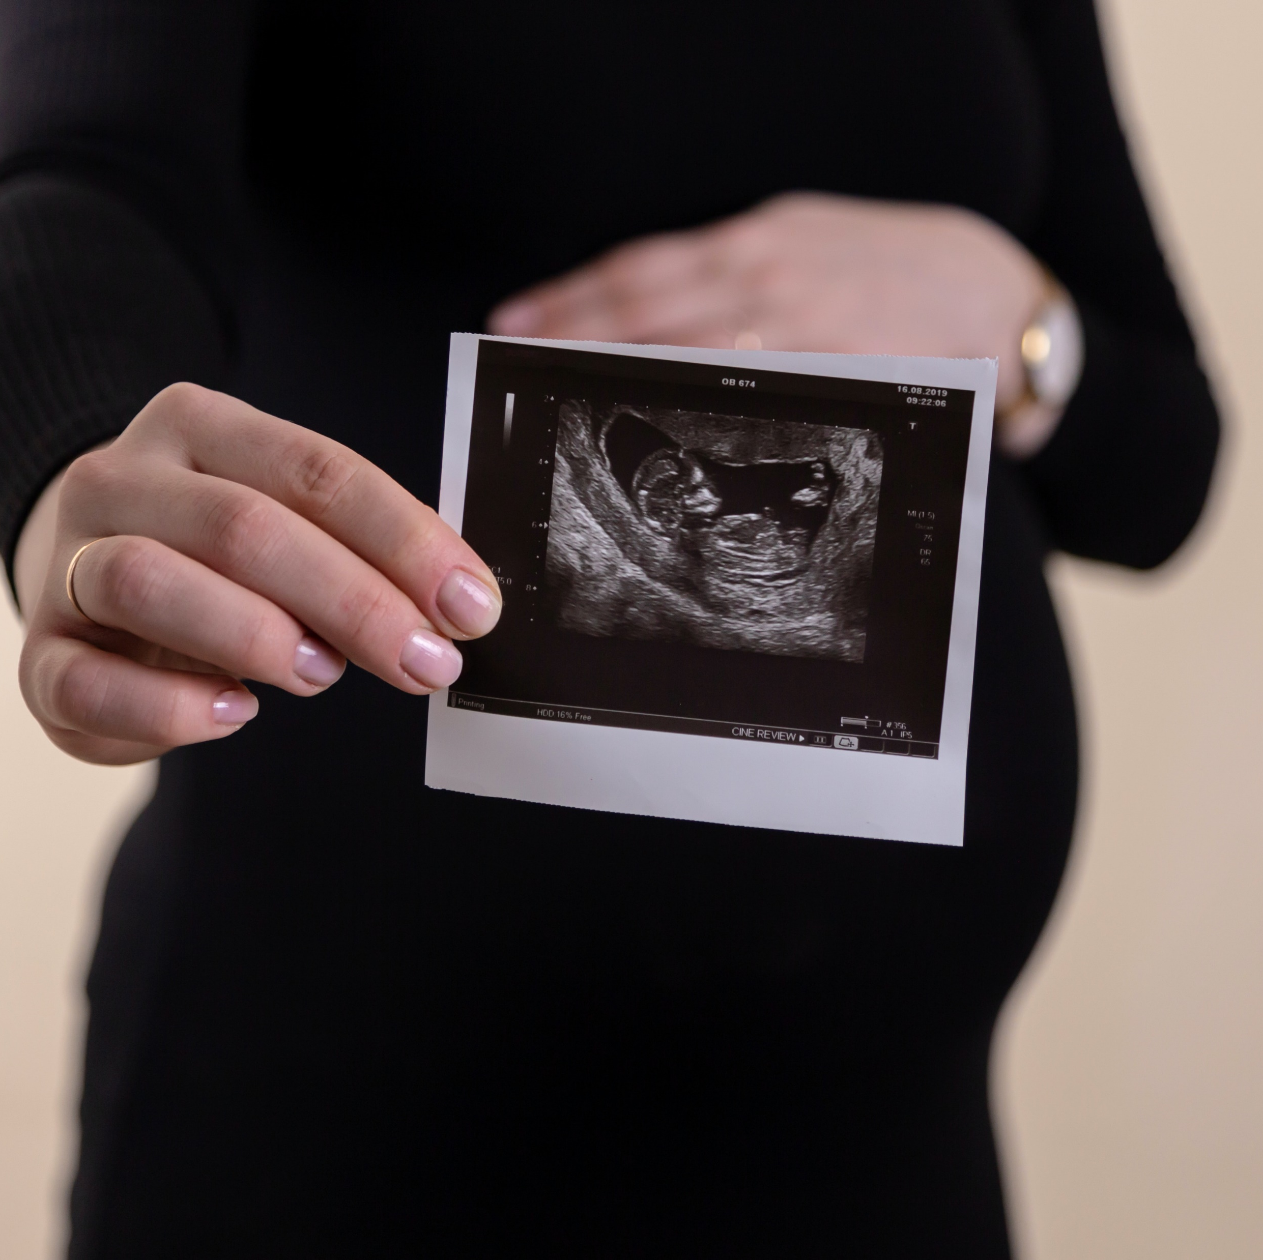
Developing a fetal classifier.
A data science project by Kenneth Imade
Photo by Volodymyr Hryshchenko on Unsplash

Slide 2
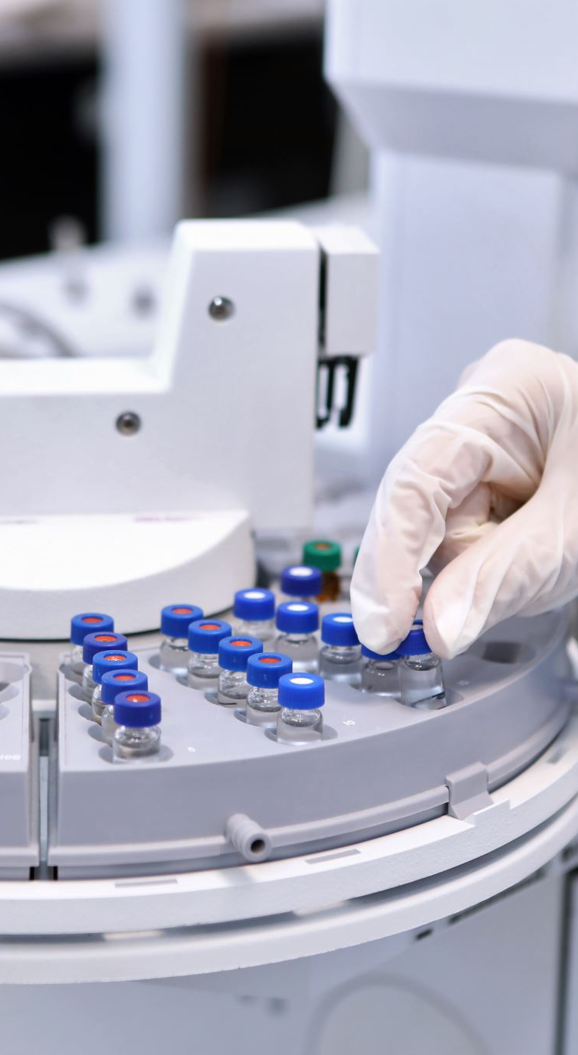
Objectives
To understand the features that determine the health status of a fetus
To develop a machine learning model capable of classifying fetus health into three categories; normal, suspect, or pathological

Slide 3
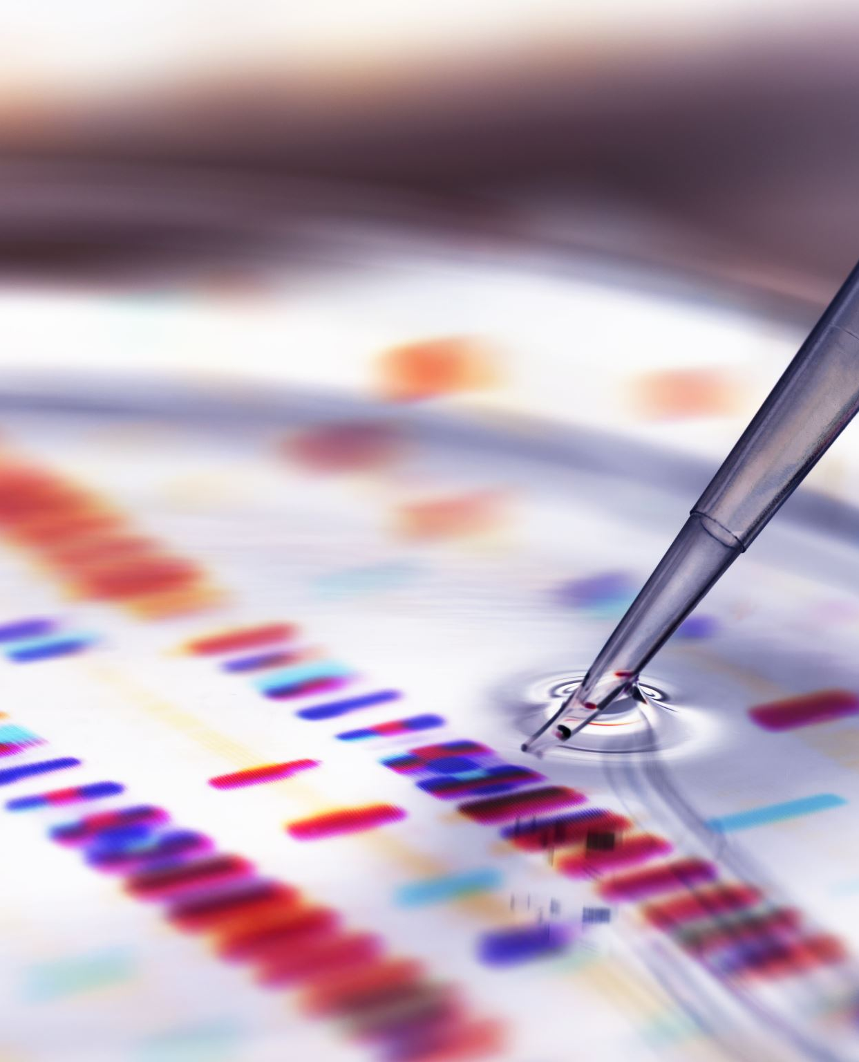
Exploratory Data Analysis

Slide 4

What is the distribution of the target variable?

Slide 5
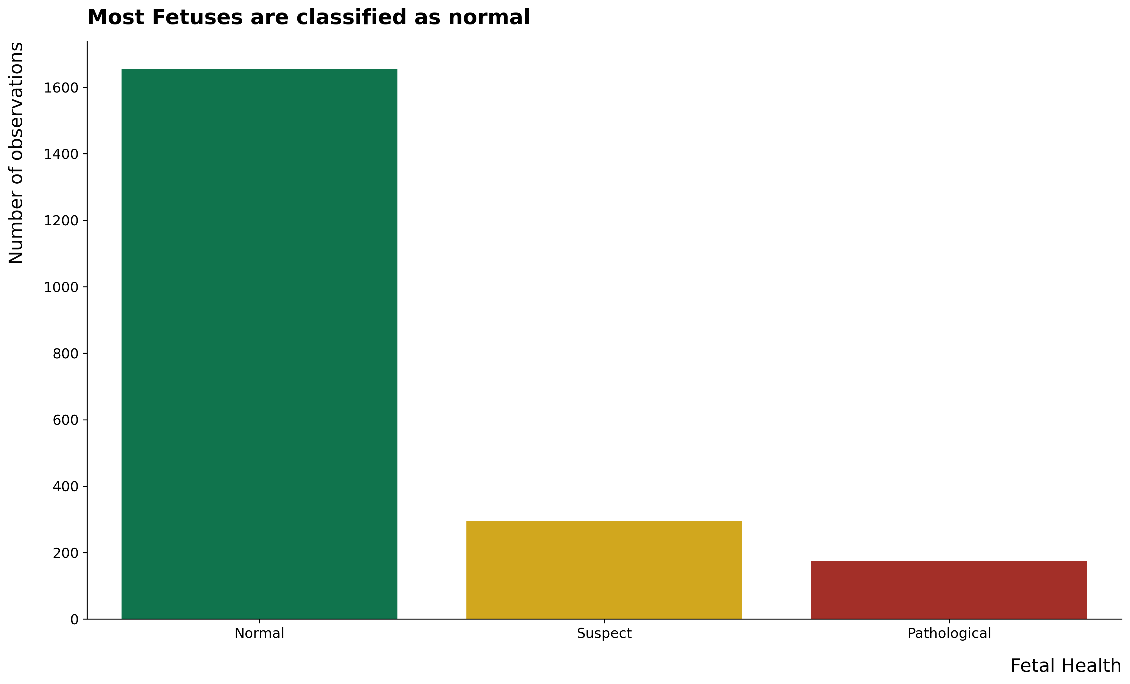

Slide 6
What is the relationship between the target variable and other variables?

Slide 7
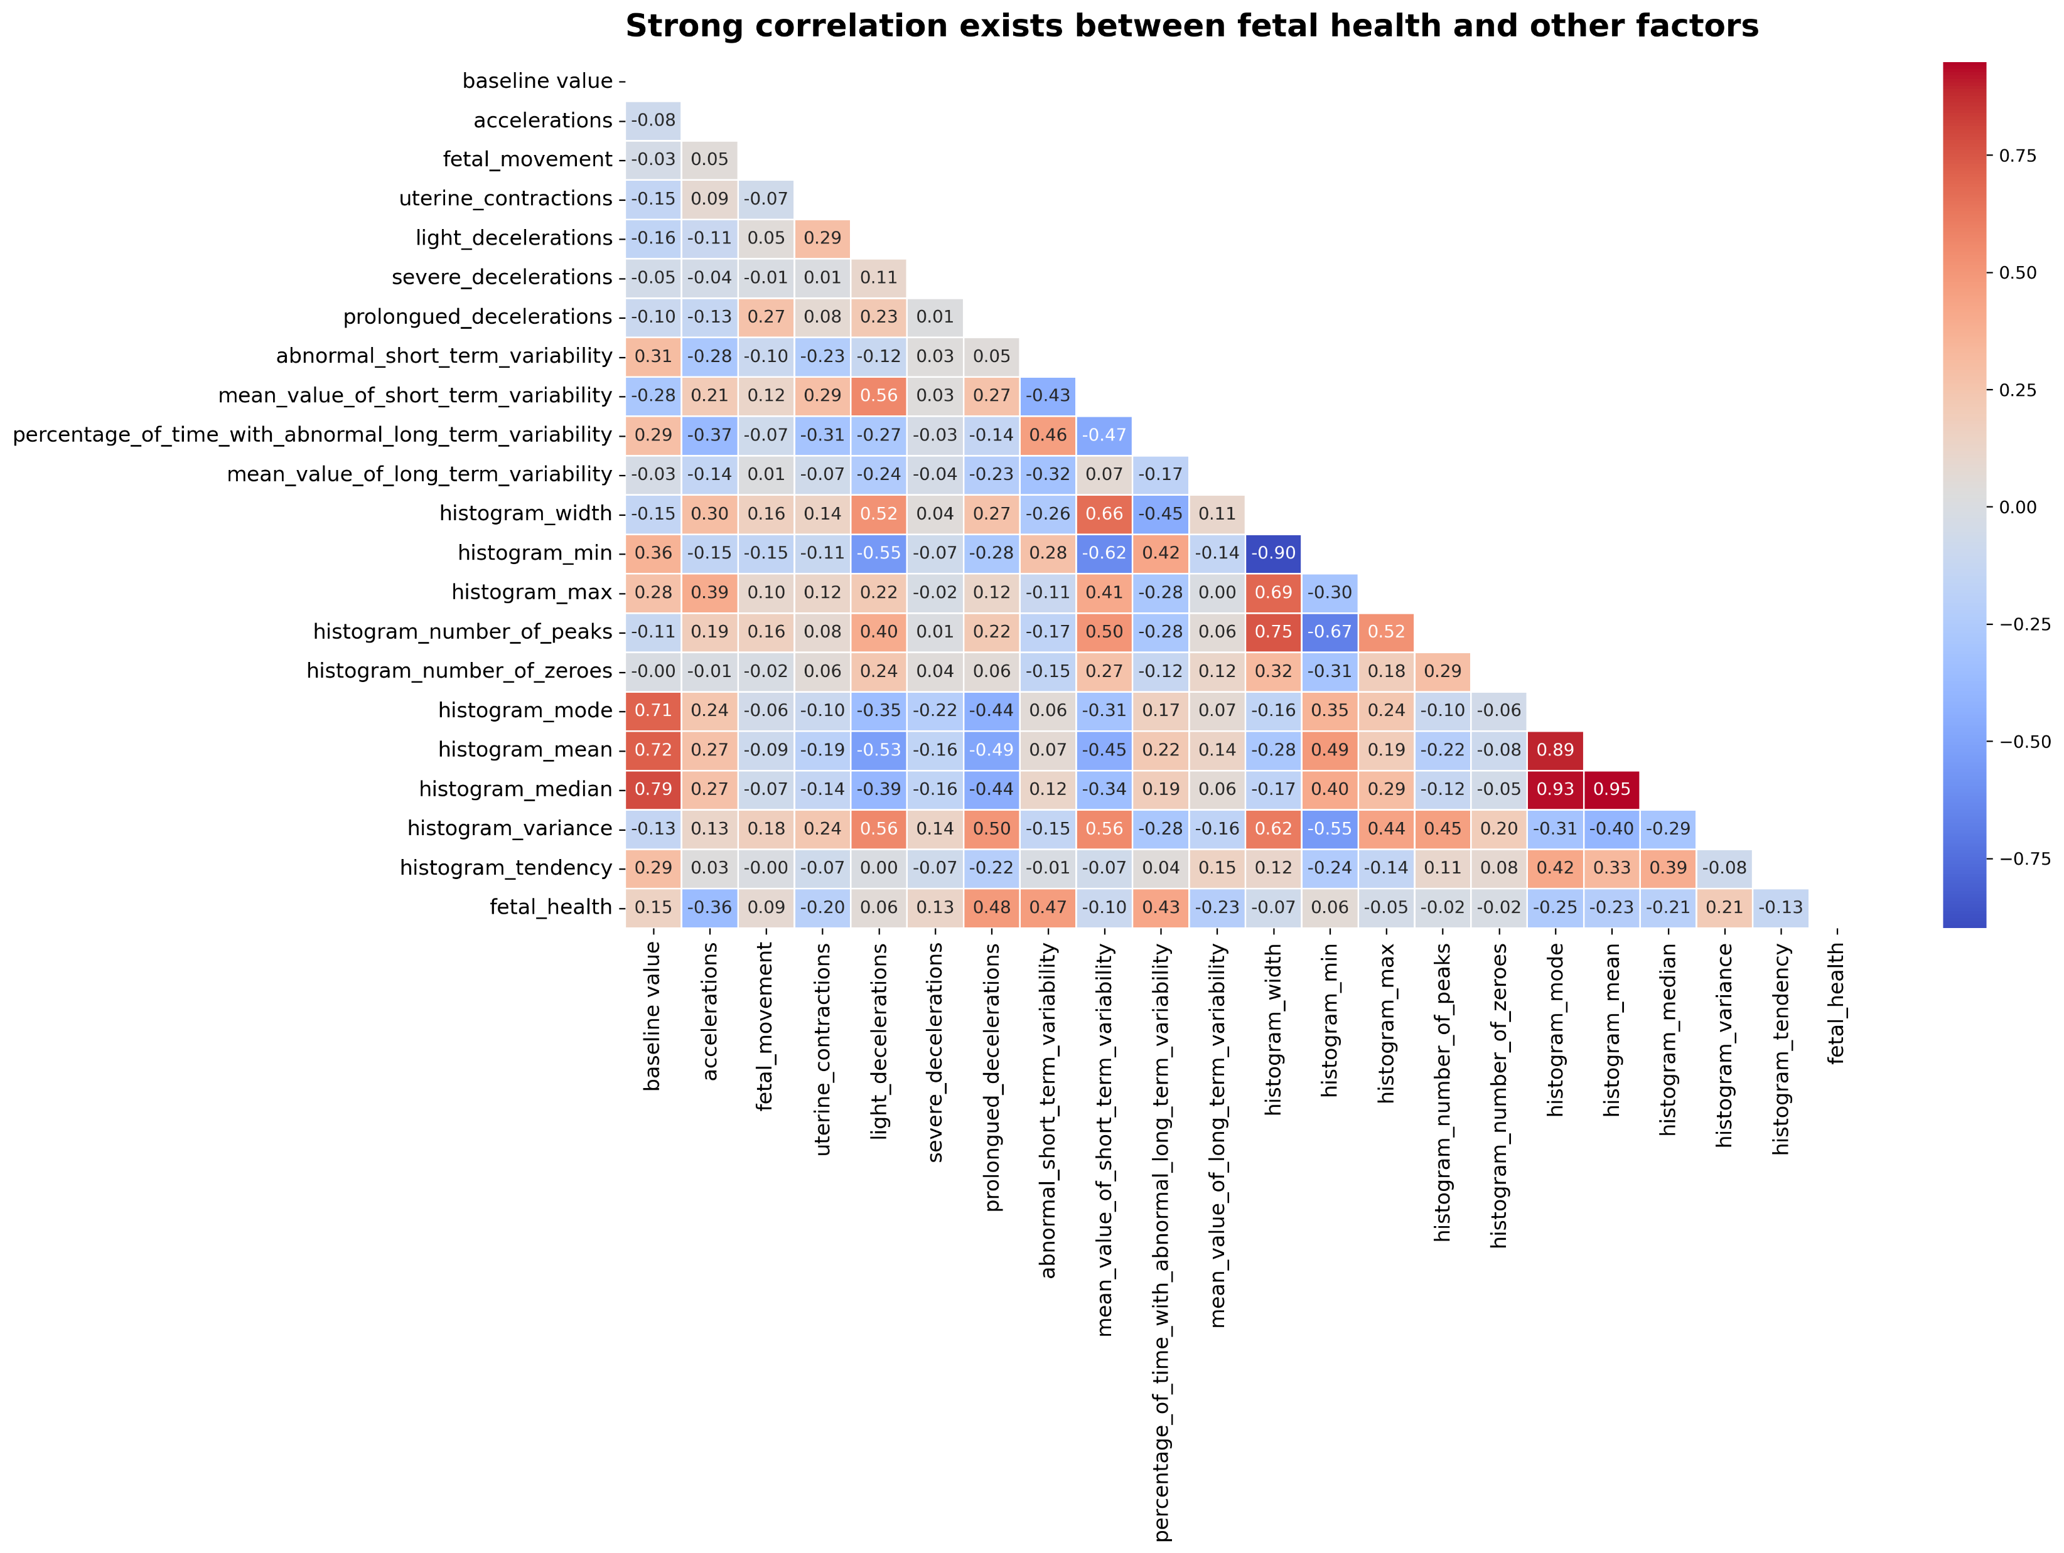

Slide 8
How does Fetal health change with respect to these variables?

Slide 9
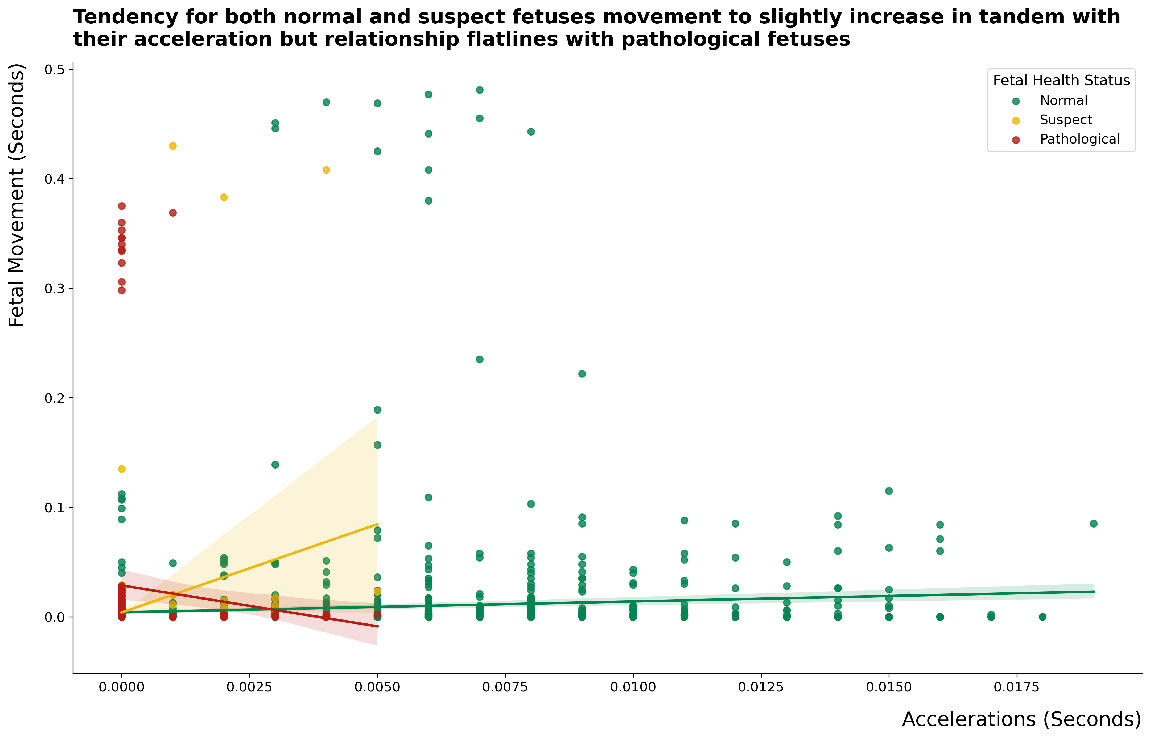

Slide 10
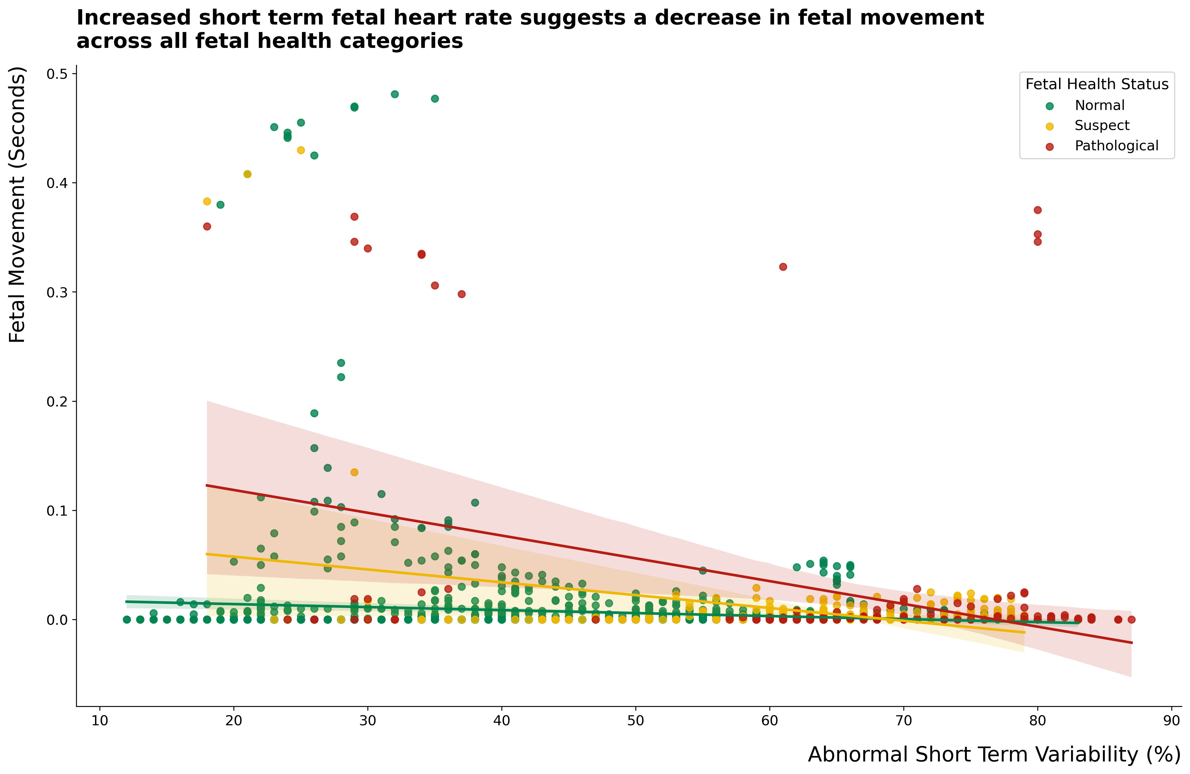

Slide 11
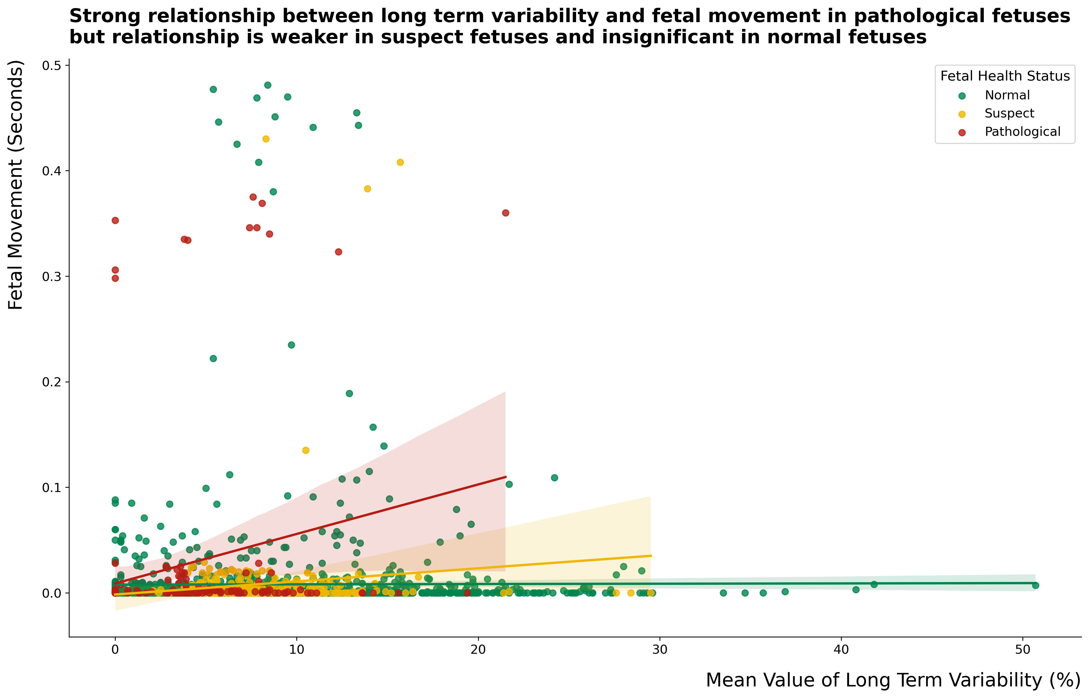

Slide 12
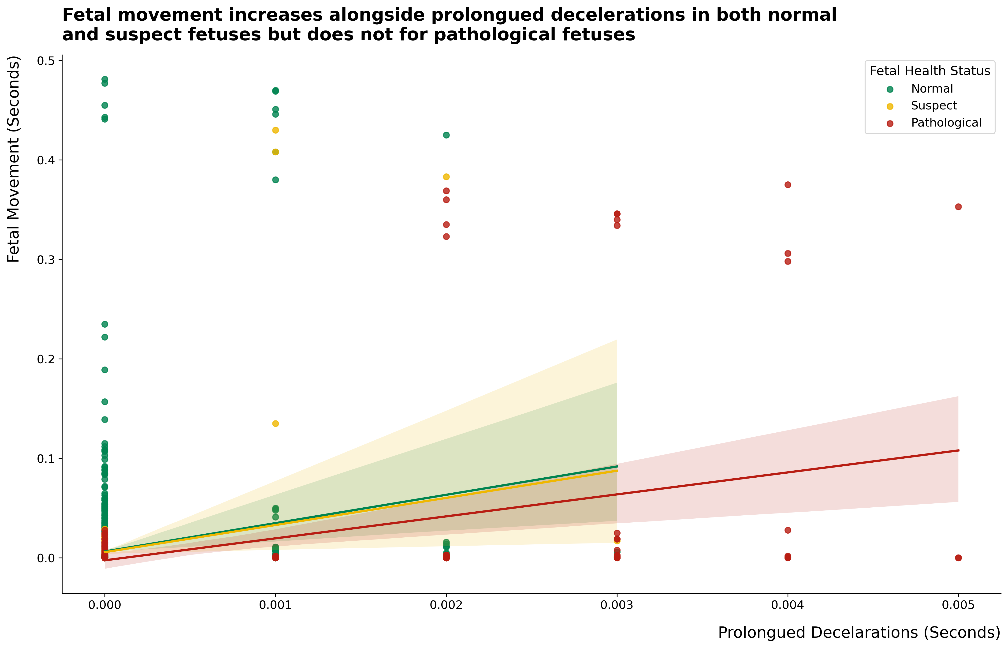

Slide 13

Data preprocessing and model building

Slide 14
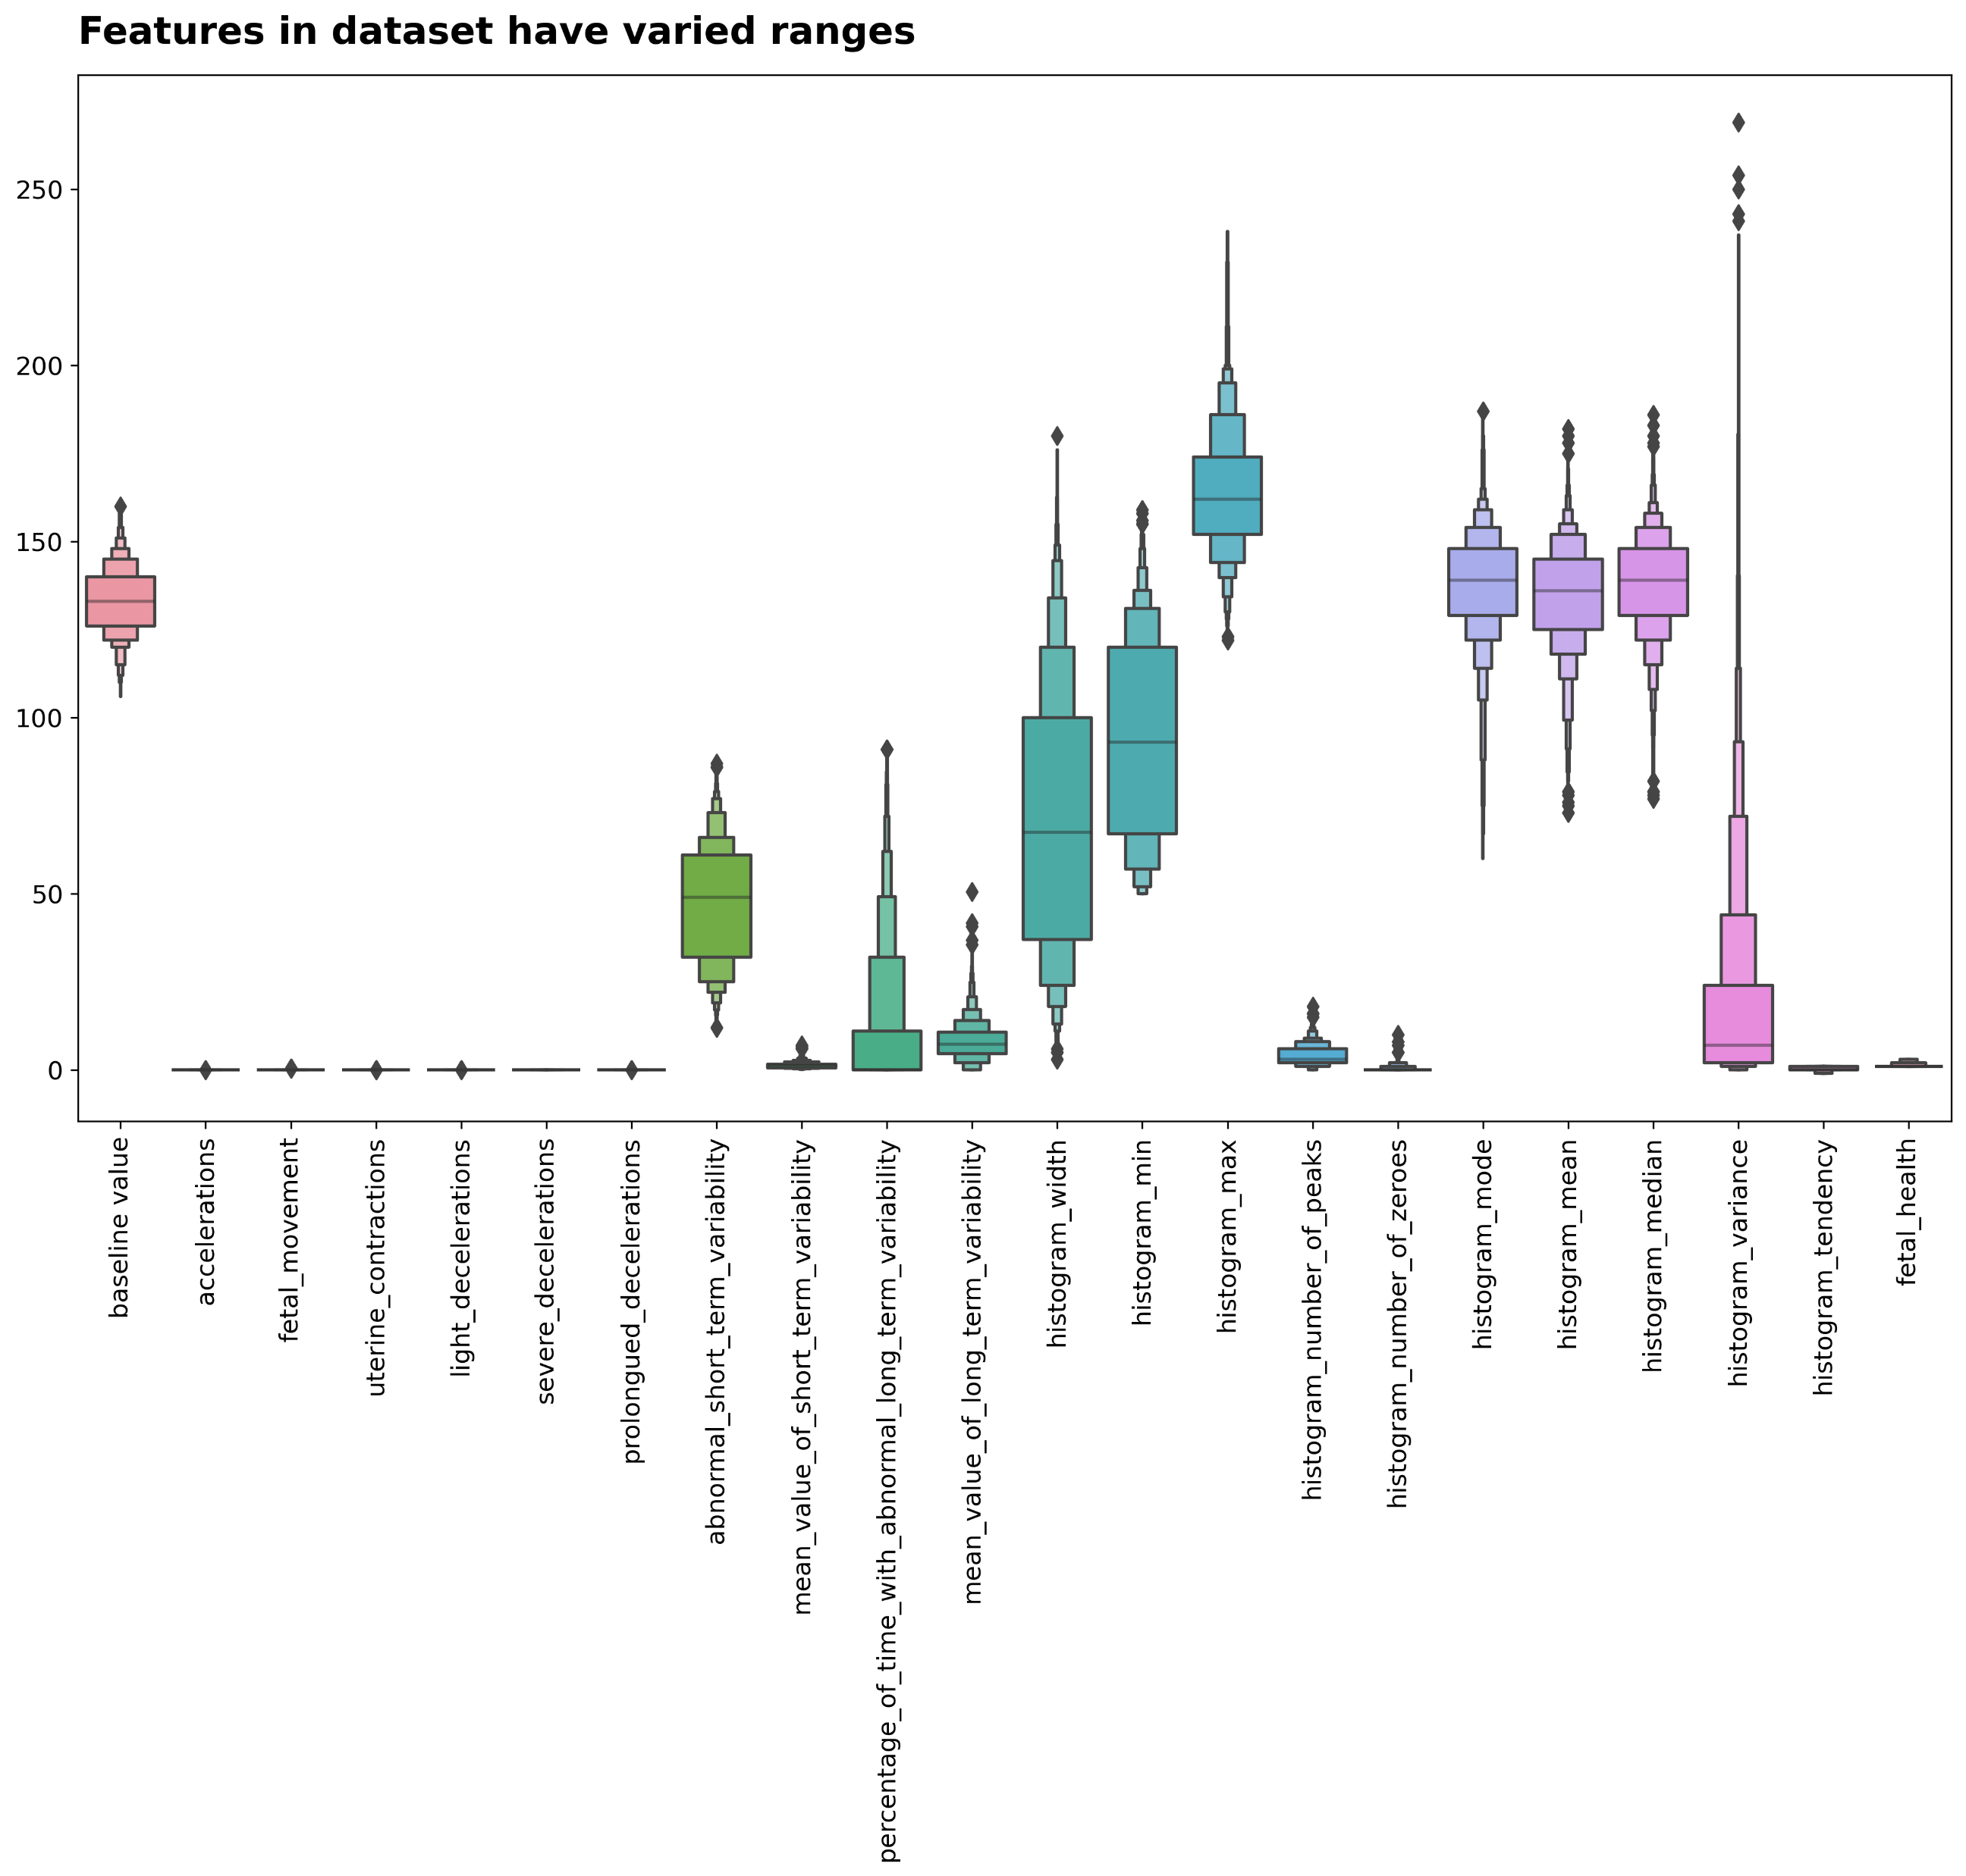

Slide 15
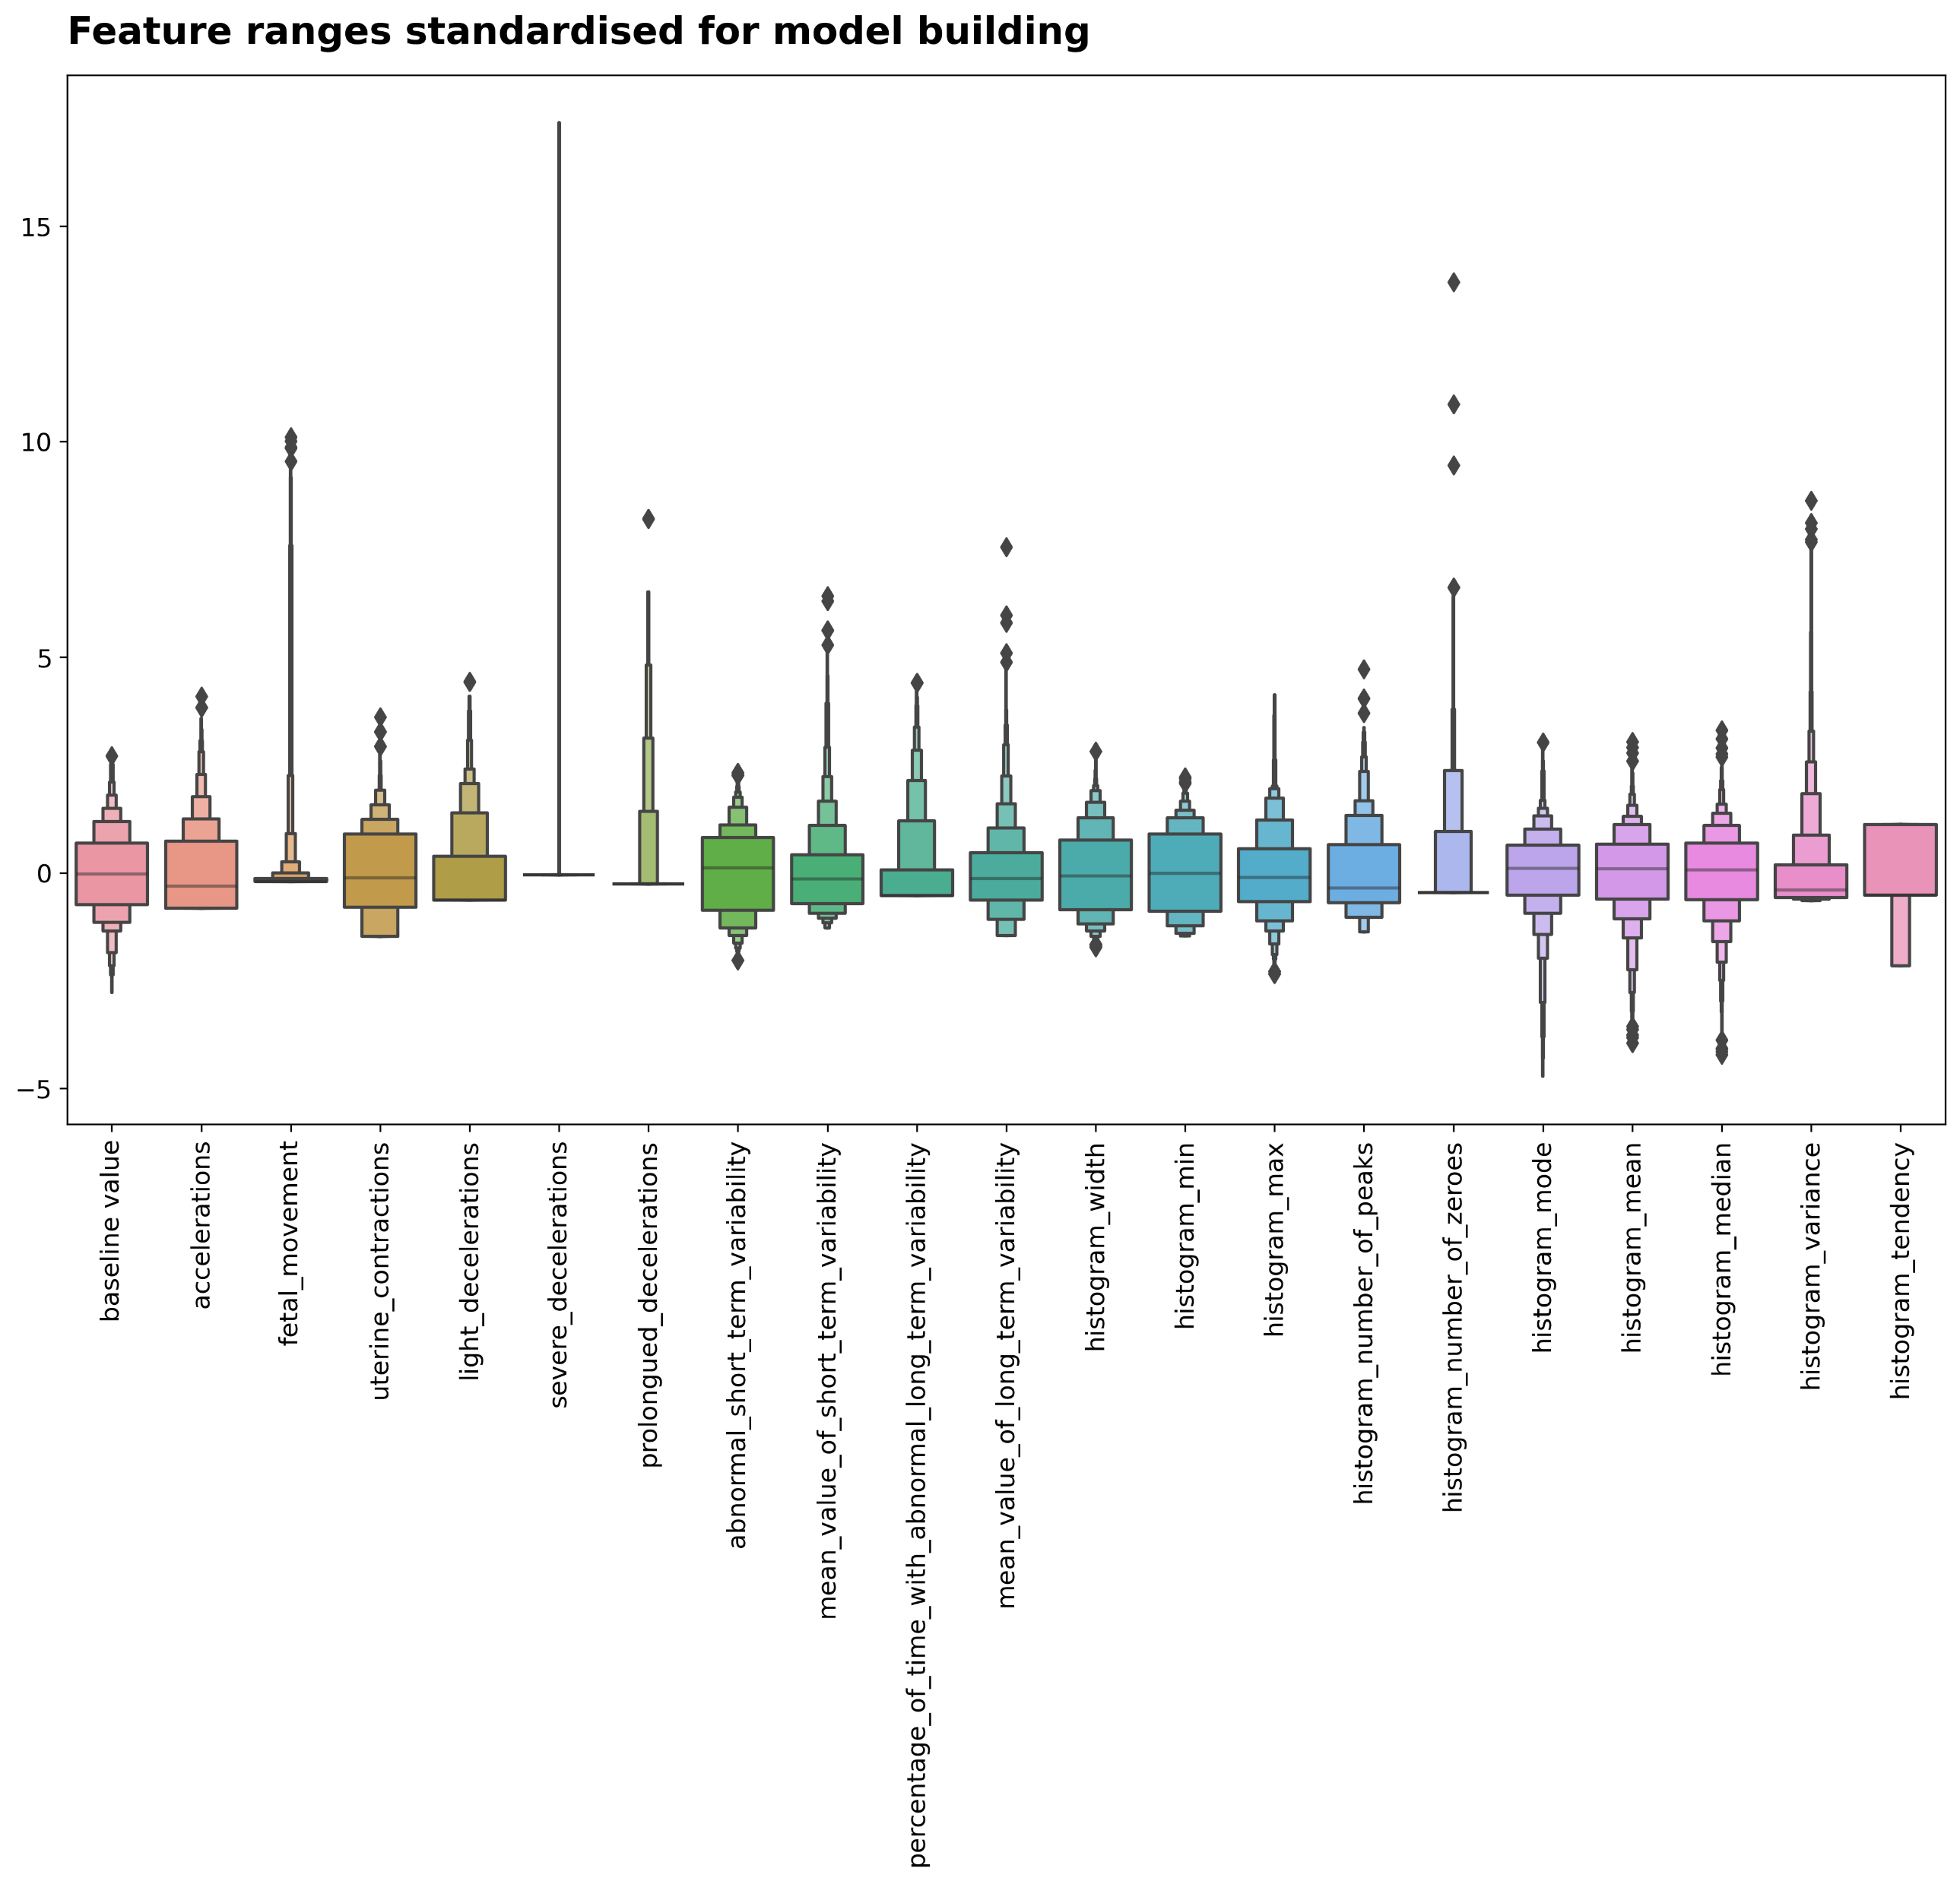

Slide 16
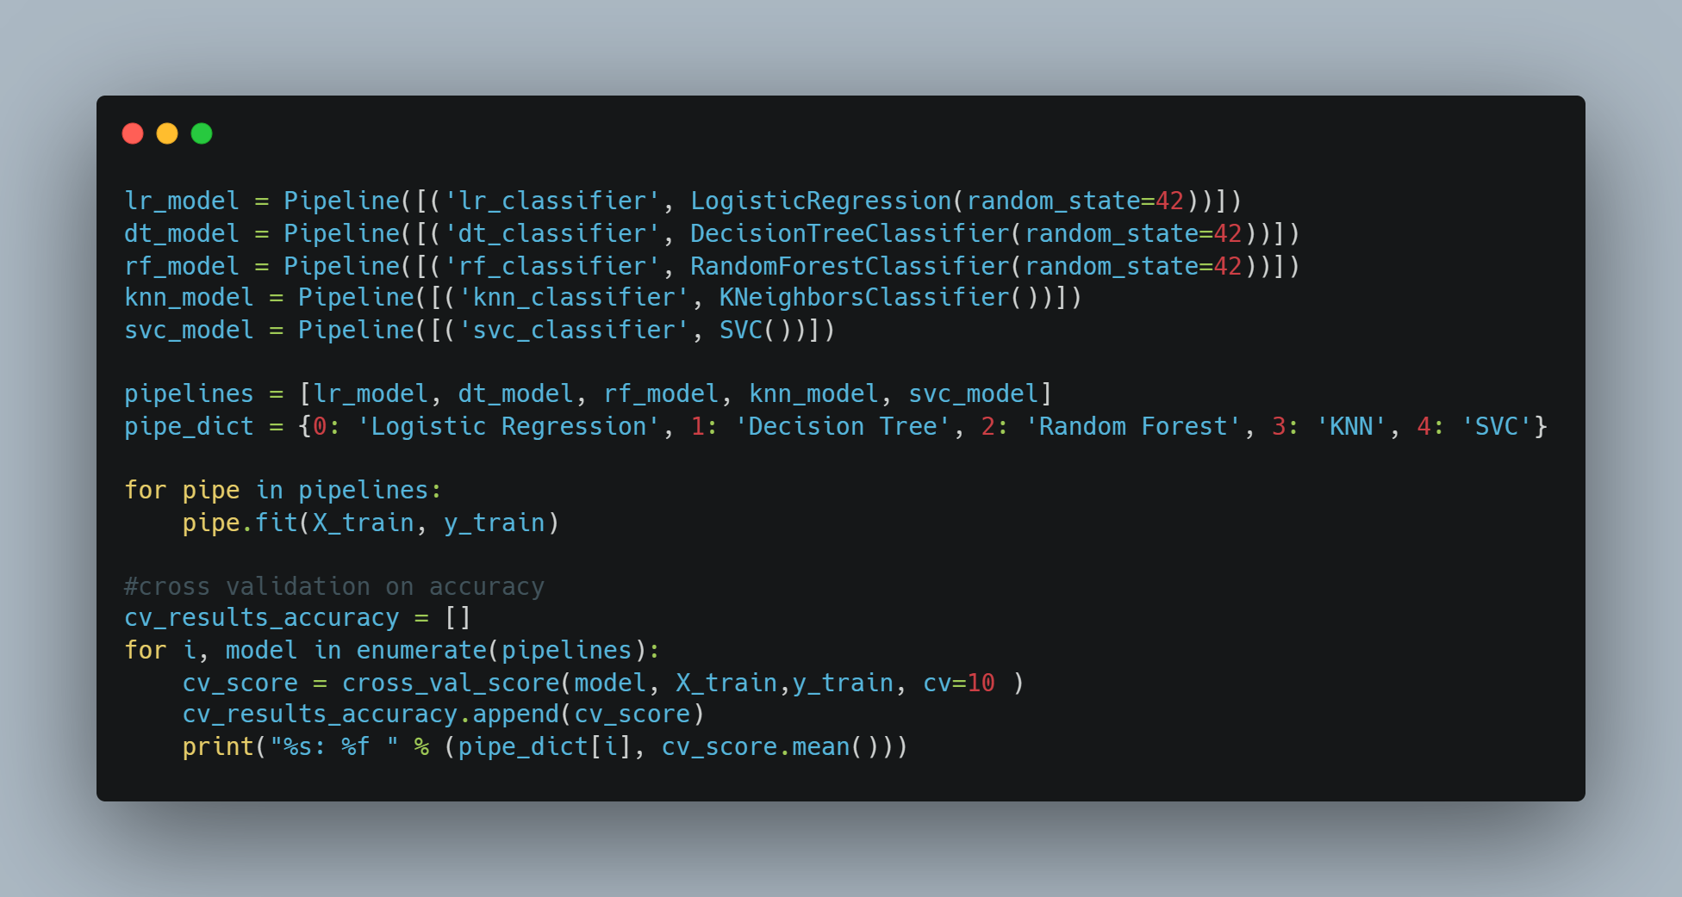
Choosing the best model

Slide 17
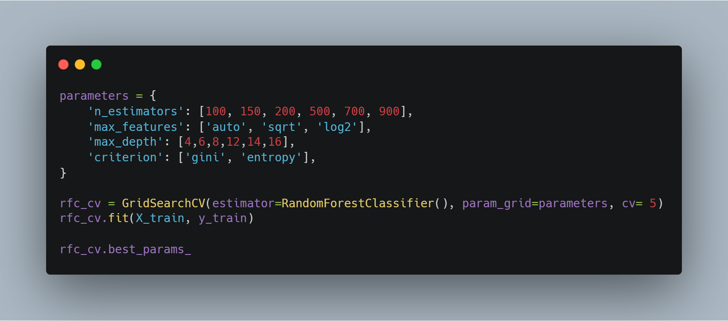
Hyper-parameter tuning.

Slide 18

Results

Slide 19
Classification Metrics
 | Precision | Recall | F1-Score | Support
Normal (1.0) | 0.96 | 0.98 | 0.97 | 496
Suspect (2.0) | 0.92 | 0.78 | 0.84 | 101
Pathological (3.0) | 0.88 | 0.93 | 0.90 | 41
Accuracy |  |  | 0.95 | 638
Macro Avg | 0.92 | 0.90 | 0.91 | 638
Weighted Avg | 0.95 | 0.95 | 0.95 | 638

Slide 20
